Slide 1

Introduction to Visual Studio.NET
Integrated Information Systems
Mike Helstrom
Solution Architect
MikeH@iisweb.com

Slide 2
Agenda
What is .NET?
.NET Framework
Visual Studio.NET
C#
Visual Basic.NET
Q & A

Slide 3
What is Microsoft .NET?
.NET represents an advanced new generation of software that will drive the Next Generation Internet. Its purpose is to make information available any time, any place, and on any device.
Quick Definition
  .NET is an initiative to integrate all Microsoft products with the “Next Generation” web.
  http://www.microsoft.com/net/
Notes:
This chart summarizes the status of Microsoft SNA Server 4.0.
By the way, SNA Server 4.0 is available now as a standalone product and as part of the
newest version of Microsoft BackOffice Server - version 4.0.

Slide 4










Next Generation Internet
Web site
Backend
App
Loosely-coupled, services connected by XML-based messages and contracts, written in many languages
Service
Service
Mega
Service
XML-
msgs
Service
Web site
Backend
App
Device
Service
Web site
Mega
Service

Slide 5
What is Microsoft .NET? (Cont.)
Core components of .NET are:
  .NET Infrastructure and Tools
  .NET Services
    An integrated set of building block services for the new Internet, including Passport.NET (for user authentication), and services for file storage, user preference management, calendar management, and many others.
  .NET User Experience
    A broader, more adaptive user experience, where information is delivered in a variety of ways on a variety of different devices.
  .NET Device Software
    Enables a new breed of smart Internet devices that can leverage Web Services
  http://www.microsoft.com/business/vision/netvision.asp

Slide 6
.NET Infrastructure and Tools
.NET Infrastructure and Tools
  .NET Enterprise Servers
    SQL 2000
    Exchange 2000
    ISA 2000
    Host Integration Server 2000
    Application Center 2000
    BizTalk Server 2000
    Commerce Server 2000
  Visual Studio.NET
  .NET Framework
  Windows.NET
    “Whistler” (Windows XP)

Slide 7
.NET Framework

Slide 8
.NET Framework
.NET Framework consists of 3 main parts:
  Common Language Runtime
  Framework Classes/Libraries
  ASP.NET
  http://msdn.microsoft.com/net

Slide 9
The .NET Framework
VB
C++
C#
JScript
…
Visual Studio.NET
Common Language Specification
ASP.NET: Web Services
and Web Forms
Windows
Forms
Windows
Forms
ADO.NET: Data and XML
Base Class Library
Common Language Runtime
Notes:
The .NET framework exposes numerous classes to the developer. These classes allow the development of rich client applications and Web based applications alike. In the above slide these classes have been divided into 4 areas.
ASP.NET provides the core Web infrastructure such as Web Forms for UI based development and Web Services for programmatic interface development,
User interface development on the Windows platform can be done using Windows Forms
ADO.NET and XML provide the functionality for data access.
Finally, the core base classes provide infrastructure services such as security, transaction management etc.

Slide 10
Common Language Runtime (CLR)
A common runtime for all .NET languages
  Common type system
  Common metadata
  Intermediate Language (IL) to native code compilers
  Memory allocation and garbage collection
  Code execution and security
Over 15 languages supported today
  C#, VB, Jscript, Visual C++ from Microsoft
  Perl, Python, Smalltalk, Cobol, Haskell, Mercury, Eiffel, Oberon, Oz, Pascal, APL, CAML, Scheme, etc.
Rational is working on Java compiler for CLR

Slide 11
Common Language Runtime (CLR)
Enables cross-language interoperability
  Common Language Specification describes interoperability requirements
Language/Hardware/OS Independent
  Compact framework for small devices
Industrial strength Garbage collector
  Designed for multi-processor servers

Slide 12
CLR: Execution Model
Source code
VB
C#
C++
Unmanaged
Component
Compiler
Compiler
Compiler
Managed
code
Assembly
IL Code
Assembly
IL Code
Assembly
IL Code
Common Language Runtime
JIT Compiler
Native Code
Operating System Services
Notes:
We already know that an assembly does NOT contain native binary code, but instead MSIL code. Obviously before the MSIL code can be executed it must be converted into native binary instructions. Converted? Does this mean interpreted? NO! The MSIL code is compiled and not thrown away. This means that next time the code is requested it is already in the form of machine instructions and thus this mechanism in the log run is far more efficient than an interpreter for example.
The compilation is carried out by a JIT (Just In Time) compiler. Does the compiler compile all of the code in one go? The answer to this question is NO. If this approach was taken there would be a long delay during the applications initialisation, and realistically not all the code within the module will be required in one go. Instead, when the code is loaded a ‘stub’ is connected to each method. When a method is called via the stub the compiler generates the binary native code. This mechanism goes a long way to describing why the compiler is called a ‘JIT’ compiler.
Compiled code is only saved in the same process (run) of an application. And even then it's not guaranteed. we do what's called "code-pitching" which means we through away cold (or little used) JITed code if memory pressure requires it. We do persisted JITed code in the install time scenario.
The benefit for to this system is obviously portability. A couple of things to think about -
Let’s imagine you’ve built a managed component for the Intel Pentium III platform. It works fine. Later in the year Intel release a super new chip. When Microsoft release a new version of the JIT, it’s possible that this brand spanking new version of the JIT will have learned a few new tricks e.g. to make use of the new improved instruction set of the new Intel chip or new CPU registers!
And finally, Microsoft plan to offer a tool called PREJIT. This tool will compile your assemblies into native code and save the resultant binary executable code to disk. When the assemblies are next loaded the binary code is already available thus improving startup time and execution speeds.

Slide 13
.NET Framework Libraries
Single consistent set of object oriented class libraries to enable building distributed web applications (Unified Classes)
Built using classes arranged across logical hierarchical namespaces
  For example: System.Data.SQL
Work with all CLR languages
  No more “VBRun” or “MFC” divide

Slide 14
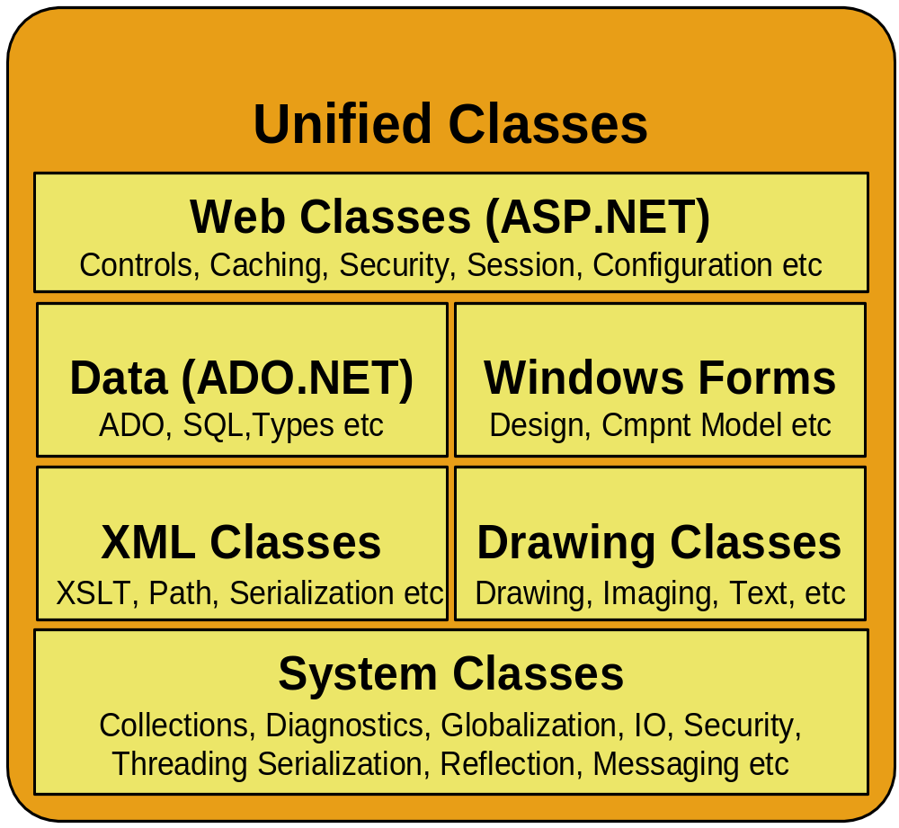
.NET Framework Libraries

Slide 15
ASP.NET
ASP.NET is a new programming framework designed to make web apps easier to:
  Build, Deploy, Run
Radical advancement of today’s ASP
  Broader programming language support
    Visual Basic.NET, Jscript.NET, C#
  Easier page programming model
    Namespaces
  Richer XML features and integration
  XCopy/FTP deployment
  Better reliability and recovery
  Excellent Visual Studio designer support

Slide 16
ASP.NET
ASP.NET is compiled, not interpreted
  Better performance
  Early binding, strong typing, JIT compiling to native code
Configuration settings in XML-based files
Session state can now be shared across a web farm of ASP.NET servers
  .NET State Server Process manages state
Application state is still single sever
ASP.NET detects and recovers from problems
  Access violations, memory leaks, deadlocks
ASP.NET supports pre-emptive cycling of apps
  Time and request based settings

Slide 17
Visual Studio.NET

Slide 18
Visual Studio.NET
Integrated Development Environment
  Visual Basic.NET
    Many language enhancements
    Inheritance,Overloading, Free Threading
  Visual C++
    Integration with .NET Framework with managed extensions (classes)
  C#
    New development language
    Based on C/C++ with Garbage Collection/Memory Management
  JUMP (Java User Migration Path) to .NET (1/25/01)
  Visual J++ has been removed from the Visual Studio suite.
  http://msdn.microsoft.com/vstudio

Slide 19
JUMP to .NET
Consists of 3 sets of tools and a service offering
  Interoperability support
  Programming tools support
  Automated conversion from Java language source code to C#
  Migration services

Slide 20
VS.NET Features
Single IDE for all Languages
Server Explorer
  Event Viewer, Message Queues, Services
  SQL Databases, Data Connection, Etc.
Integrated IE Browser
HTML/XML Editors
Macros/Macro Explorer
Solution Explorer
Tabbed Documents
Dynamic Help
Common Forms Editor
  VB.NET, C++, and C#

Slide 21
Visual Studio.NET Demo

Slide 22
C#

Slide 23
Intro to C#
Design Goals of C#
  Component Orientated Language
  Robust and Durable Software
Features
  Classes
  Namespaces
  No header files
VB.NET vs. C#
  Ability to embed C++ code in C# code
  Elegance of C/C++ language
Notes:
<none>

Slide 24
Design Goals C#
Component Oriented
  Properties, methods, events
Robust and Durable
  Garbage collection (No memory leaks and stray pointers)
  Exception Handling
  Type-safety (No uninitialized variables)
Based on C++
Interoperability
  Support for XML, SOAP

Slide 25
Visual Basic.NET

Slide 26
Visual Basic.NET
Leave it in VB6
  WebClasses, ActiveX Documents, DHTML Projects
Thinking in VB.NET
  Data Types, Type vs. Structure
  Property Functions, Zero Bound Arrays
  Default Parameters
New Features
  Forms Designer, Declaration Syntax
  Structured Exception Handling
  Overloading, Inheritance
  Free Threading
ADO.NET

Slide 27
VB.NET: Data Types
True is now = 1
Integer Data type has changed
  Short (Int16), Integer (Int32), Long (Int64)
  VB 6
  VB.NET
Dim intAge As Integer
Dim intID As Long
Dim intAge As Short
Dim intID As Integer

Slide 28
VB.NET: Type vs. Structure
Defining user defined types (UDT) has a new syntax
VB 6
VB.NET
Type Customer
CustomerNumber as Long
CustomerName As String
CustomerCompany As String
End Type
Structure Customer
Public CustomerNumber as Integer
Public CustomerName As String
Public CustomerCompany As String
End Structure

Slide 29
VB.NET: Property Functions
VB 6
VB.NET
Public Property Get CustomerName() As String
CustomerName = m_CustName
End Property
Public Property Let CustomerName(sCustName As String)
m_CustName = sCustName
End Property
Public Property CustomerName() As String
Get
CustomerName = m_CustName
End Get
Set
m_CustName = Value
End Set
End Property

Slide 30
VB.NET: Zero Bound Arrays
Option Base 1|0 has been removed
All arrays are base 0
The following declaration has 5 elements, arrElements(0) thru arrElements(4)
Dim arrElements(5) As String

Slide 31
VB.NET: Default Properties
Default properties are no longer supported.
Important! Early Binding is key in VB6
VB 6
VB.NET
Note: Recordset (COM ADO) is not the preferred data storage object in VB.NET, this is just an example.
txtAddress = rs(“Addr_1”)
lblFName = “First Name”
txtAddress.Text = rs(“Addr_1”).value
lblFName.Text = “First Name”

Slide 32
VB.NET Forms Designer
New Forms Designer
  VB.NET, C++, C#
Enhanced Menu Editor
Control Anchors
New Properties
Visual Inheritance

Slide 33
VB.NET Demo

Slide 34
VB.NET: New Declaration Syntax
Variables can now be declared and initialized on declaration line.
VB 6
VB.NET
Dim intLoop As Integer
intLoop = 10
Dim intLoop As Integer = 10

Slide 35
VB.NET: Structured Exception Handling
VB.NET supports elegant error handling
VB 6
VB.NET
On Error Goto ErrTag
...
‘clean up
Exit Function
ErrTag:
‘error handling
‘clean up
End Function
Try
...
Catch
‘error handling
Finally
‘clean up
End Try

Slide 36
VB.NET: Overloading
Functions can now be overloaded (accept arguments of different types)
VB.NET
Overloads Function ConvertSQL(ByVal strString As String) As String
ConvertSQL = "'" & strString & "'"
End Function
Overloads Function ConvertSQL(ByVal intNum As Integer) As String
ConvertSQL = CStr(intNum)
End Function

Slide 37
VB.NET: Inheritance
Public Class Customer
Private m_CustName As String
Public Property CustomerName() As String
Get
CustomerName = m_CustName
End Get
Set
m_CustName = Value
End Set
End Property
End Class
Public Class CustCompany
Inherits Customer
Private m_CustCompany As String
Public Property CustomerCompany() As String
Get
CustomerCompany = m_CustCompany
End Get
Set
m_CustCompany = Value
End Set
End Property
End Class

Slide 38
ADO.NET
ADO.NET is the preferred data access method in the .NET Framework
Better support for disconnected data access
Specialized namespaces
  System.Data.SQL – Tuned for SQL Server
  System.Data.ADO – OLEDB
Portable
  Native XML Support

Slide 39
ADO.NET
ADOConnection
  Similar to Connection object in ADO
ADOCommand
  Similar to Command object in ADO
ADODataSetCommand
  Somewhat like Recordsets for ADO.NET (DataSet)
  Designed for stateless operations
ADODataReader
  For streaming methods, similar to Stream
SQLConnection, SQLCommand, and SQLDataSetCommand, SQLDataReader

Slide 40
VB.NET Demo

Slide 41
VB 6 Moving Forward
Avoid
  Web Classes, ActiveX Docs, DHTML Apps
Development Techniques
  Early Binding
  Don’t use Default Properties
  Use Constants (such as true)
  Avoid GoSub
  Use ByVal and ByRef explicitly (ByVal is now default)
  Use ADO
VB6 to VB.NET Conversion Techniques
  Relax, take breaks often

Slide 42
Resources
Microsoft
  http://www.microsoft.com/net
  http://msdn.microsoft.com/net
Programmer Resources
  http://www.gotdotnet.com
  http://www.devx.com
VB6 to VB.NET Whitepaper
  http://msdn.microsoft.com/library/techart/vb6tovbdotnet.htm
Example Site
  http://www.ibuyspy.com

Slide 43
TechNet Briefing
Microsoft TechNet Briefing, Portland, ME
3/27/01 9:00AM – 12:00PM
Co-located at the Maine Technology Job Fair http://www.mainetechnologyjobfair.com/
Attendees receive a FREE copy of SQL Server 2000 Evaluation Edition (120 day) and ISA Enterprise Edition Evaluation (120 day). Topics include: Using Microsoft Project 2000 and Visio 2000 to plan and track your Windows 2000 deployment, and How to make full use of Office and Windows 2000 Web integration.

Slide 44

Questions?
http://www.iisweb.com

